Slide 1




Sustainable Supply Chain Performance Dashboard in Power BI
Presented by: Tuba Rahat

Slide 2
Learning Objectives
Understand the fundamental principles of sustainable supply chain management.
Develop expertise in building interactive dashboards using Power BI.
Learn to import and integrate data from various sources, including CSV files, into Power BI.
Utilize advanced Power BI features like DAX calculations, measures, and calculated columns for data analysis.
Enhance visual storytelling skills to effectively present sustainability performance to different audiences

Slide 3
Tools and technology used
Data Visualization: Power BI Data Processing: Microsoft Excel / SQL Data Sources: Open-source supply chain data, company reports

Slide 4
Problem Statement
Traditional supply chains often lack visibility into sustainability metrics.
Compaines struggle to monitor carbon footprint, energy consumption, and ethical sourcing.
Ineffiecient reporting leads to poor decision-making in sustainable practices.

Slide 5
Solution:
A real-time, interactive dashboard for tracking sustainability metrics.
Visualizing carbon footprint, supplier performance, waste reduction, and energy efficiency.
Customizable reports for decision-makers to enhance sustainability efforts.

Slide 6
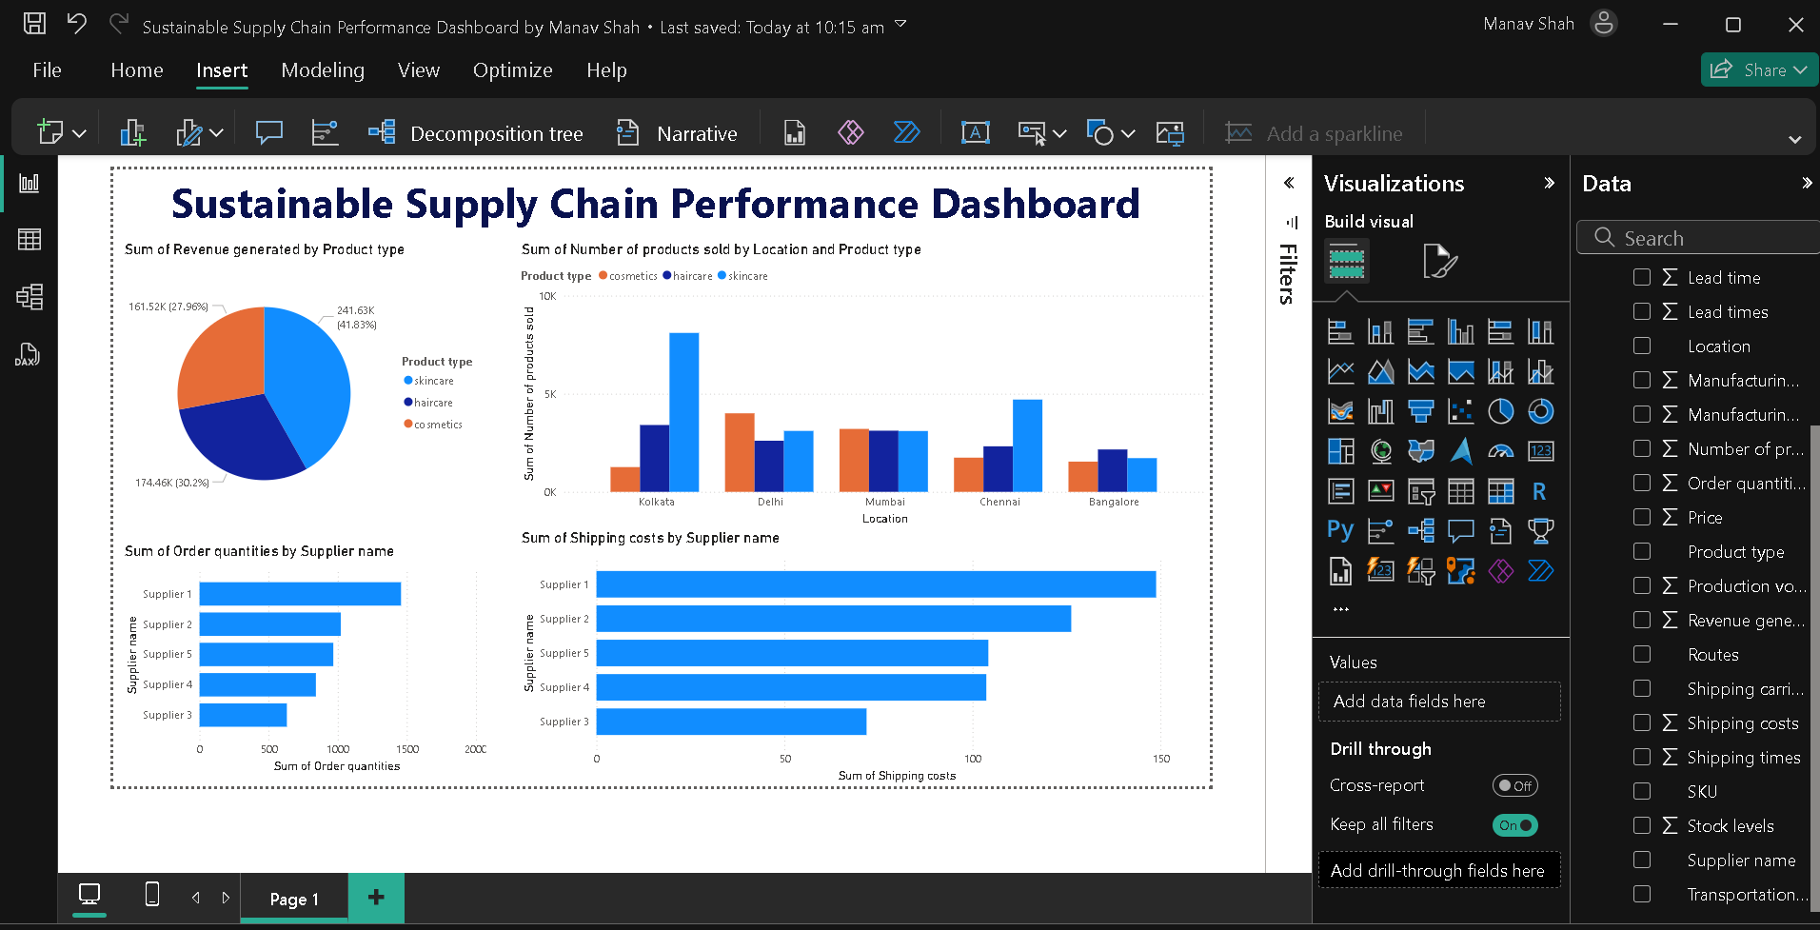

Slide 7
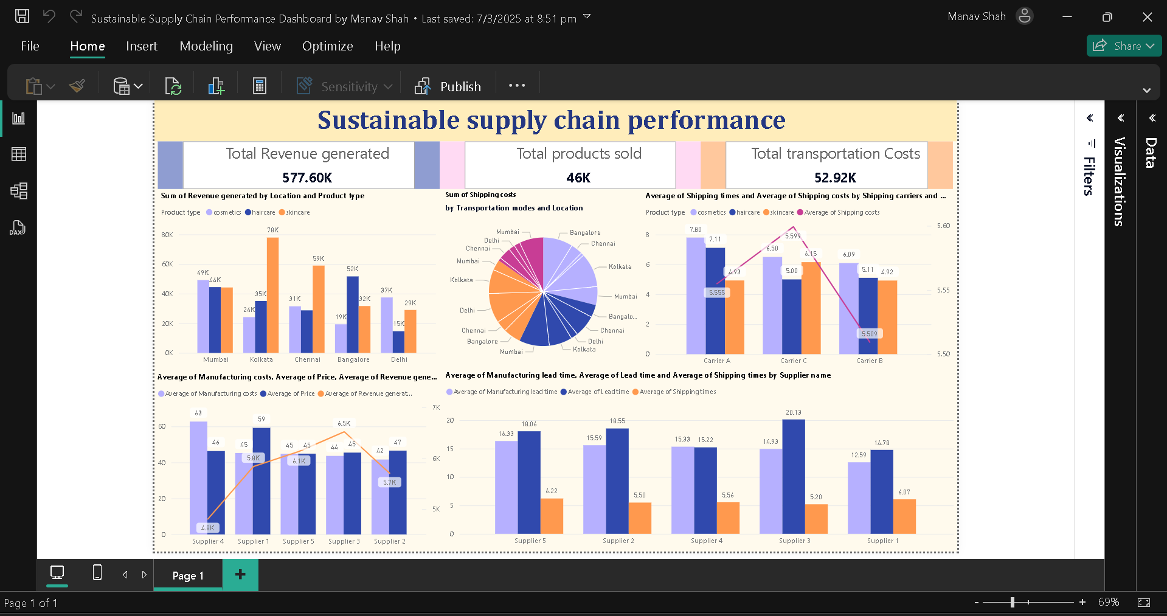

Slide 8
Conclusion:
The project highlights the importance of data-driven decision-making in sustainable supply chains.
Power BI enables efficient monitoring and reporting of sustainability KPIs.
Future improvements could include AI-driven predictive analytics for proactive sustainability measures.

Slide 9
Thank You!
Notes:
Thank You !!

